Slide 1
Software Requirements Engineering
Lectures 6 and 7
Engr. Sara Rehmat

Slide 2
Contents
A requirements development process framework
The Business Analyst
Notes:
‹#›

Slide 3

A requirements development process framework
Notes:
‹#›

Slide 4
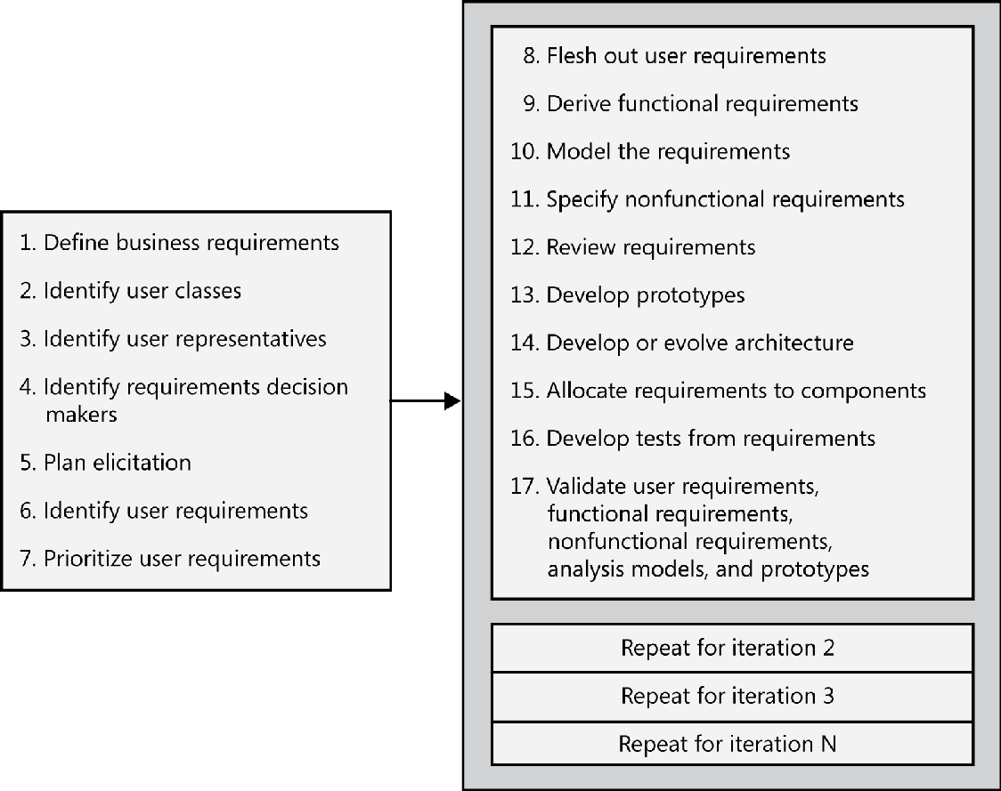
A requirements development process framework
Notes:
‹#›

Slide 5
Requirements management encompasses practices that help you deal with requirements after you have them in hand.
These practices include version control and baselining, change control, tracking requirements status, and tracing requirements to other system elements.
Requirements management will take place throughout the project’s duration at a low level of intensity.
Notes:
‹#›

Slide 6
Requirements Development Efforts for different SDLCs
The total requirements effort might not be much different for projects of comparable size that follow different life cycles, but the timing distribution of requirements work is very different .
Notes:
‹#›

Slide 7
Requirements Effort in Waterfall model
In the pure waterfall life cycle, you plan to do only one major release, so most of the requirements development effort is allocated for the beginning of the project.
But even if you plan a traditional “requirements phase” at the beginning of the project that then leads into design, you can count on having to do some additional requirements work throughout the project.
Notes:
‹#›

Slide 8
Requirements Effort in Iterative Process Models
Projects that follow an iterative development process, such as the Rational Unified Process will work on requirements on every iteration through the development process, with a heavier emphasis in the first iteration.
Notes:
‹#›

Slide 9
Requirements Effort in Agile Process Models
Agile and other incremental development projects aim to release functionality every few weeks.
They will have frequent but small requirements development efforts.
Such projects begin by collecting user requirements in the form of simple user stories that describe major objectives the user wants to accomplish with the help of the system.
You need to learn enough about the stories so that you can estimate their development effort and prioritize them.
Prioritizing these user requirements lets you determine which ones to allocate to specific development increments, called iterations or sprints.
Those allocated requirements can be explored in further detail in a just-in-time fashion for each development cycle.
Notes:
‹#›

Slide 10
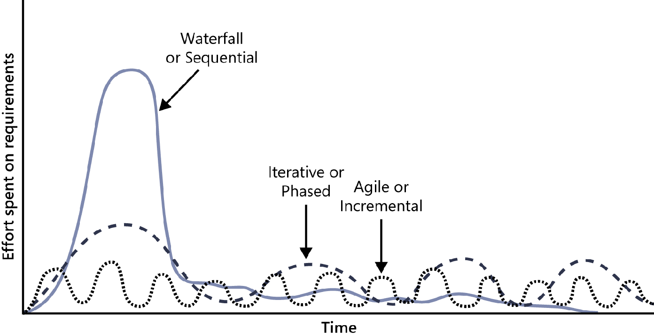
The distribution of requirements development effort over time varies for projects that follow different development life cycles
Notes:
‹#›

Slide 11
Business Analyst
The role of Business Analyst
The Business Analyst’s tasks
Essential analyst skills
Essential analyst knowledge
The making of a business analyst
The role of a business analyst on agile projects
Creating a collaborative team

Slide 12
Business Analyst
The business analyst is the individual who has the primary responsibility to elicit, analyze, document, and validate the needs of the project stakeholders.
Difference between a BA and a Project Manager
The BA plays a central role in collecting and disseminating product information, whereas the project manager takes the lead in communicating project information.
A project manager needs to create and manage plans, including schedules and resource needs, based on work that BAs define.
Difference between a BA and a Product Manager
In organizations that develop consumer products, the analyst role is often the product manager’s or marketing staff’s responsibility.
Essentially, the product manager acts as a BA, often with additional emphasis on understanding the market landscape and anticipating external users’ needs. If the project has both a product manager and a BA, typically the product manager focuses on the external market and user demands, and the BA converts those into functional requirements.

Slide 13
Business Analyst
Explicitly or implicitly, someone performs the role of business analyst (BA) on every software project.
The analyst helps stakeholders find the difference between what they say they want and what they really need.
Synonyms for business analyst include requirements analyst, systems analyst, requirements engineer, requirements manager, application analyst, business systems analyst, IT business analyst, and simply analyst.
Using highly experienced analysts can reduce the project’s overall effort by one-third compared to similar projects with inexperienced analysts.

Slide 14
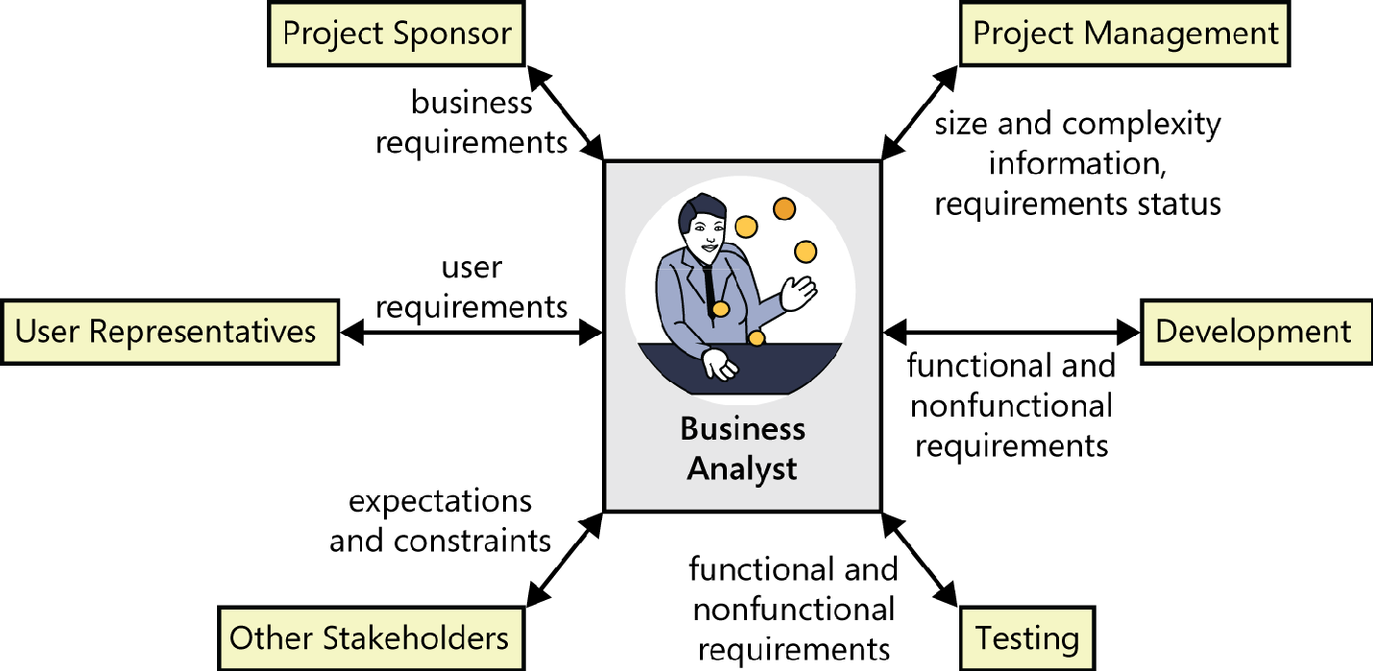

Slide 15
The business analyst’s tasks
Define business requirements
Plan the requirements approach
Identify project stakeholders and user classes
Elicit requirements
Analyze requirements
Document requirements
Communicate requirements
Lead requirements validation
Facilitate requirements prioritization
Manage requirements

Slide 16
Essential analyst skills
Listening skills
Interviewing and questioning skills
Thinking on your feet
Analytical skills
Systems thinking skills
Learning skills
Facilitation skills
Leadership skills
Observational skills
Communication skills
Organizational skills
Modeling skills
Interpersonal skills
Creativity

Slide 17
Essential analyst knowledge
Business analysts need a breadth of knowledge, much of which is gained through experience.
Understand contemporary requirements engineering practices and how to apply them in the context of various software development life cycles.
They might need to educate and persuade those who are not familiar with established requirements practices.
The effective analyst has a rich tool kit of techniques available and knows when—and when not—to use each one.
An analyst with a sound understanding of project management, development life cycles, risk management, and quality engineering can help prevent requirements issues from torpedoing the project.
The business-savvy analyst can minimize miscommunications with users.
Analysts who understand the organization and business domains often detect unstated assumptions and implicit requirements. They can suggest ways that users could improve their business processes or propose valuable functionality that no other stakeholder thought of.
Understanding

Slide 18
The making of a business analyst
Let’s explore how people with different backgrounds might move into the analyst role and see some of the challenges and risks they’ll face.
The former user
The former developer or tester
The former (or concurrent) project manager
The subject matter expert as a business analyst
The rookie as a business analyst

Slide 19
The former user as a business analyst
Corporate IT departments often have business analysts who migrated into that role after working on the business side as a user of information systems.
Advantages
These individuals understand the business and the work environment, so they can easily gain the trust of their former colleagues. They speak the user’s language, and they know the existing systems and business processes.
Disdavantages
They might know little about software engineering or how to communicate with technical people.
Some former users believe they understand what is needed better than current users do, so they don’t solicit or respect input from those who will actually use the new system.

Slide 20
The former developer as a business analyst
Those developers who enjoy collaborating with customers to understand the needs that drive software development are good candidates to specialize in business analysis.
The developer-turned-analyst might need to learn more about the business domain.
Developers will benefit from training and mentoring in the diverse soft skills that the best

Slide 21
The former tester as a Business Analyst
A tester often has an analytical mind-set that can lend itself to being a good BA.
Testers are already used to thinking about exceptions and how to break things, a useful skill for finding gaps in requirements.
As with a former developer, a tester will have to learn about good requirements engineering practices and also need to become more knowledgeable about the business domain.

Slide 22
The former (or concurrent) project manager
Advantages
Project managers will already be used to working with the appropriate teams, understanding the organization and business domains.
Equipped with necessary soft skills.
Disadvantages
The former project manager will have to learn more about requirements engineering practices.
They must learn to focus on understanding the business needs and prioritizing those within existing project schedules, rather than focusing on timelines, resources, and budget constraints.
They will need to develop the analysis, modeling, and interviewing skills that are less important for project managers but are essential to BA success.

Slide 23
The subject matter expert as a business analyst
Advantages
SMEs can determine, based on their experience, whether the requirements are reasonable, how they extend the existing system, how the proposed architecture should be designed, and the impacts on users, among other areas.
Disadvantages
SMEs are expert in their understanding of the “as-is” system; they sometimes have difficulty imagining the “to-be” system. It often works better to have a BA from the development team work with the SME, who then serves as a key user representative or product champion.

Slide 24
The rookie as a business analyst
Advantages
Becoming a business analyst is a good entry point into the information technology arena for someone right out of school or coming from a completely unrelated job.
An advantage of hiring a novice as a BA is that he will have few preconceived notions about how requirements processes should work.
Disadvantage
Because he lacks related experience and knowledge, a new graduate will have much to learn about how to execute the BA tasks and the details

Slide 25
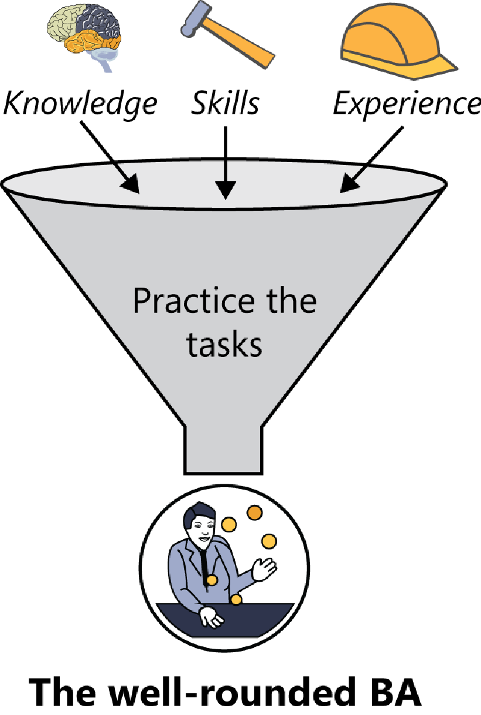

Slide 26
The analyst role on agile projects
Following are a few suggestions for a BA to apply her skills on an agile project:
Define a lightweight, flexible requirements process and adapt it as the project warrants.
Ensure that requirements documentation is at the right level: not too little and not too much. Help determine the best approach to document the backlog, including whether story cards or more formal tools are most appropriate.
Apply facilitation and leadership skills to ensure that stakeholders are talking to one another frequently about requirements needs, questions, and concerns.
Help validate that customer needs are accurately represented in the product backlog, and facilitate backlog prioritization.
Work with customers when they change their minds about requirements and priorities, and help record those changes.
Work with the rest of the team to determine the impact of changes on iteration contents and release plans.

Slide 27
Creating a collaborative team
The business analyst has the major responsibility for forging a collaborative relationship among the user representatives and other project stakeholders.
The analyst steers the project participants toward a requirements agreement that leads to a win-win-win outcome in the following ways:
Customers are delighted with the product.
The developing organization is happy with the business outcomes.
All team members are proud of the good work they did on a challenging and rewarding project.

